Slide 1
Compiler Design (22CS302) III B.Tech – I Semester
Department of Computer Science and Engineering

Slide 2
The Lexical-Analyzer Generator LEX
The main job of a lexical analyzer (scanner) is to break up an input stream into more usable elements (tokens).
a = b + c * d ;
ID ASSIGN ID PLUS ID MULT ID SEMI
Lex is an utility to help you rapidly generate your scanners
Department of Computer Science and Engineering

Slide 3
An Overview of Lex
Lex source program lex.l
Lex compiler
lex.yy.c
lex.yy.c
C compiler
a.out
Input stream
a.out
tokens
Creating a lexical analyzer with Lex
Department of Computer Science and Engineering

Slide 4
Structure of LEX program
Lex source is separated into three sections by %% delimiters.
The general format of Lex source is:
declarations
%%
transition rules
%%
auxiliary functions
Department of Computer Science and Engineering

Slide 5
LEX program – Declarations Section
The declarations section includes declarations of variables, manifest constants (identifiers declared to stand for a constant, e.g., the name of a token), and regular definitions.

Slide 6
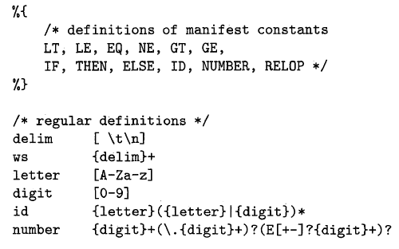
LEX program – Declarations Section

Slide 7
LEX program – Translation Rules
The translation rules each have the form
Pattern {Action}
Lex source is a table of
regular expressions and
corresponding program fragments (actions)
Each pattern is a regular expression, which may use the regular definitions of the declaration section.

Slide 8
LEX program – Translation Rules
a = b + c;
a operator: ASSIGNMENT b + c;
…
%%
<regexp> <action>
<regexp> <action>
…
%%
%%
“=“ printf(“operator: ASSIGNMENT”);

Slide 9
LEX program – Translation Rules
regexp <one or more blanks> { actions (C code) }
A null statement ; will ignore the input (no actions)
[ \t\n];
Causes the three spacing characters to be ignored
a = b + c;
d = b * c;
↓ ↓
a=b+c; d=b*c;

Slide 10
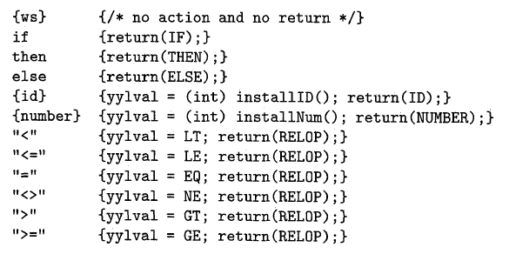
LEX program – Translation Rules

Slide 11
LEX program – auxiliary functions
The third section holds whatever additional functions are used in the actions.
Alternatively, these functions can be compiled separately and loaded with the lexical analyzer.

Slide 12
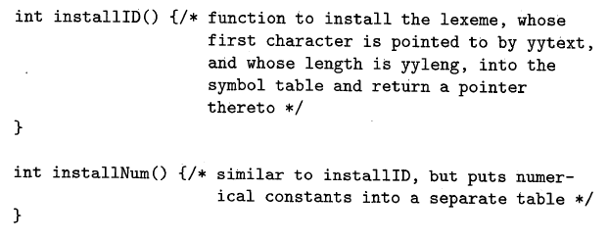
LEX program – auxiliary functions

Slide 13
Lex Predefined Variables
yytext → a string containing the lexeme
yyleng → the length of the lexeme
yyin → the input stream pointer
the default input of default main() is stdin
yyout → the output stream pointer
the default output of default main() is stdout.

Slide 14
Lex Library Routines
yylex()
The default main() contains a call of yylex()
yymore()
return the next token
yyless(n)
retain the first n characters in yytext
yywarp()
is called whenever Lex reaches an end-of-file
The default yywarp() always returns 1

Slide 15
%{
#include<stdio.h>
%}
delim [\t\n]
ws {delim}+
letter [A-Za-z]
digit [0-9]
id {letter}({letter}|{digit})*
num {digit}+(\.{digit}+)?(E[+\-]?{digit}+)?
%%
ws {printf("no action");}
if {printf("if is a keyword");}
{id} {printf("%s is a identifier",yytext);}
{num} {printf("it is a number");}
"<" {printf("it is a relational operator");}
%%
main()
{
yylex(); return 1;
}

Slide 17
THANK YOU
Department of Computer Science and Engineering

